Slide 1
Introduction to Database Development and ER Model

Slide 2
Overview of the Design Process
Requirement's specification
initial phase of database design is to characterize fully the data needs of the prospective database users.
The database designer needs to interact extensively with domain experts and users to carry out this task.
Identify essential "real world" information
Remove redundant, unimportant details
Clarify unclear natural language statements
Fill remaining gaps in discussions
Distinguish data and operations

Slide 3
Overview of the Design Process
Conceptual-design
designer chooses a data model and, by applying the concepts of the chosen data model, translates these requirements into a conceptual schema of the database.
The schema provides a detailed overview of the enterprise.
The entity-relationship model is typically used to represent the conceptual design.

Slide 4
Overview of the Design Process
Next stage is to move from an abstract data model to the implementation of the database
logical-design phase
This step typically consists of mapping the conceptual schema defined using the entity-relationship model into a relation schema.
physical-design phase
In this step, physical features of the database are specified. These features include the form of file organization and choice of index structures.

Slide 5
Data Modelling
Data modeling is the process of creating a data model for the data to be stored in a database.
The Data Model is defined as an abstract model that describe data, data relationships, data semantics and consistency constraints
The data model emphasizes on what data is needed and how it should be organized instead of what operations will be performed on data.
The data models can be classified into four different categories
Relational Model
Entity-Relationship Model
Object-Based Data Model
Semi-structured Data Model

Slide 6
Data Model
Relational Model
The relational model uses a collection of tables (relations) to represent both data and the relationships among those data.
Each table has a name that is unique among other relations
Multiple columns, and each column has a unique name
Tuple: each row in a relation
Entity-Relationship Model
The Entity-Relationship (ER) data model allows us to describe the data involved in a real-world enterprise in terms of objects and their relationships.
Widely used to develop an initial database design.
Move from informal description of what user wants to precise description of what can be implemented in a DBMS

Slide 7
Data Model
Object-Based Data Model
Extension of the ER model with notion of encapsulation, methods (functions) and object identity
It groups its related functionalities together and allows inheriting its functionality to other related sub-groups.
Semistructured Data Model:
The semistructured data model permits the specification of data where individual data items of the same type may have different set of attributes
The Extensible Markup Language, also known as XML, is widely used for representing the semistructured data.

Slide 8
Database Design
Before we look at how to create and use a database we’ll look at how to design one
Need to consider
What tables, keys, and constraints are needed?
What is the database going to be used for?
Conceptual design
Build a model independent of the choice of DBMS
Logical design
Create the database in a given DBMS
Physical design
How the database is stored in hardware

Slide 9
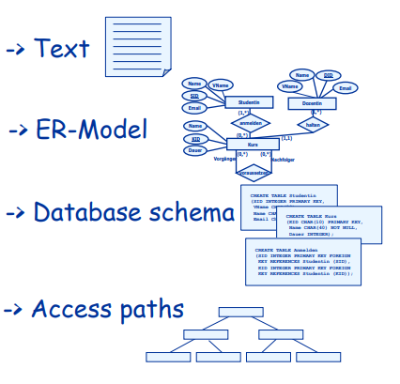
Steps in developing a database
Requirements analysis
Conceptual Database design
Logical Database design
Physical Database design
Applications and security

Slide 10
Conceptual design
ER Model is used at this stage
What are the entities and relationships in the enterprise?
What information about these entities and relationships should we store in the database?
What are the integrity constraints or business rules that hold?
A database `schema’ in the ER Model can be represented pictorially (ER diagrams).
Can map an ER diagram into a relational schema.

Slide 11
ER Model Basics
Entity
Real-world object distinguishable from other objects.
For example, each student in a university is an entity
An entity is described using a set of attributes. Each attribute has a domain.
Each entity has a value for each of its attributes.
For example, a particular student entity have the value 12321 for Roll No., the value Shyam for name

Slide 12
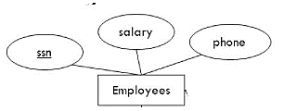
ER Model Basics
Entity Set:
Set of entities of the same type that share the same properties, or attributes. The set of all employees at a given university, for example can define the entity set employees.
Each entity set has a key.

Slide 13
Keys
Minimal set of attributes which uniquely identify an instance of a entity
Many candidate keys choose one to be a primary keys
SSN vs Name … key must be unique

Slide 14
ER Model Basics
Relationship
Association among two or more entities. For example, we can define a relationship works in that associate's employee Ram with department Computer Science
Relationships have
A name
A set of entities that participate in them
A degree - the number of entities that participate (most have degree 2)
A cardinality ratio

Slide 15
Cardinality Ratios
Each entity in a relationship can participate in zero, one, or more than one instances of that relationship
This leads to 3 types of relationship
One to one (1:1)
Each lecturer has a unique office
One to many (1:M)
A lecturer may tutor many students, but each student has just one tutor
Many to many (M:M)
Each student takes several modules, and each module is taken by several students

Slide 16
Example
A university consists of a number of departments. Each department offers several courses. A number of modules make up each course. Students enrol in a particular course and take modules towards the completion of that course. Each module is taught by a lecturer from the appropriate department, and each lecturer tutors a group of students

Slide 17
Example - Entities
A university consists of a number of departments. Each department offers several courses. A number of modules make up each course. Students enrol in a particular course and take modules towards the completion of that course. Each module is taught by a lecturer from the appropriate department, and each lecturer tutors a group of students

Slide 18
Example-Relationships
A university consists of a number of departments. Each department offers several courses. A number of modules make up each course. Students enrol in a particular course and take modules towards the completion of that course. Each module is taught by a lecturer from the appropriate department, and each lecturer tutors a group of students

Slide 19
Example - ER Diagram
Entities: Department, Course, Module, Lecturer, Student
Department
Course
Module
Lecturer
Student

Slide 20
Example - ER Diagram
Each department offers several courses
Offers
Department
Course
Module
Lecturer
Student

Slide 21
Example - ER Diagram
A number of modules make up each courses
Offers
Department
Course
Includes
Module
Lecturer
Student

Slide 22
Example - ER Diagram
Students enrol in a particular course
Offers
Department
Course
Includes
Module
Lecturer
Enrols In
Student

Slide 23
Example - ER Diagram
Students … take modules
Offers
Department
Course
Includes
Module
Lecturer
Takes
Enrols In
Student

Slide 24
Example - ER Diagram
Each module is taught by a lecturer
Offers
Department
Course
Includes
Module
Teaches
Lecturer
Takes
Enrols In
Student

Slide 25
Example - ER Diagram
a lecturer from the appropriate department
Offers
Department
Employs
Course
Includes
Module
Teaches
Lecturer
Takes
Enrols In
Student

Slide 26
Example - ER Diagram
each lecturer tutors a group of students
Offers
Department
Employs
Course
Includes
Module
Teaches
Lecturer
Takes
Enrols In
Student
Tutors

Slide 27
Example - ER Diagram
Offers
Department
Employs
Course
Includes
Module
Teaches
Lecturer
Takes
Enrols In
Student
Tutors

Slide 28
Reference
Database Management Systems 3ed, R. Ramakrishnan and J. Gehrke
Entity/Relationship Modelling, Database Systems Lecture 4, Natasha Alechina

